Slide 1
UMET9U-30-1- Professional Skills for Banking and Finance Lecture 21
Presented by
Reinhold Heinlein
March 2026

Slide 2
Lecture content
Regression analysis
Computing coefficients
Interpretation of coefficients

Slide 3
Regression analysis
Regression analysis is a statistical method for estimating the relationship between a dependent variable and one or more independent variables.
Simple or Bivariate regressions have only one independent variable
We might be interested in relationships between:
Consumption and income
Inflation and unemployment
Sales revenue and advertisement

Slide 4
Example
A firm wishes to test the hypothesis that more advertising will result in more sales and also wants to test the strength of the relationship i.e. by how much will sales increase for every additional £1 spent on advertising.
Sales Revenue is the dependent variable (Y) and advertising expenditure is the independent or explanatory variable (X). Values are in thousands of Pound (1 unit = £1,000).
Year (t) | 1 | 2 | 3 | 4 | 5 | 6 | 7 | 8 | 9 | 10
Advertising Expenditure (X) | 10 | 9 | 11 | 12 | 11 | 12 | 13 | 13 | 14 | 15
Sales Revenue(Y) | 44 | 40 | 42 | 46 | 48 | 52 | 54 | 58 | 56 | 60

Slide 5
Scatter graph
A scatter graph plotting advertisement expenditures versus sales revenues.
There seems to be a strong positive relationship.

Slide 6
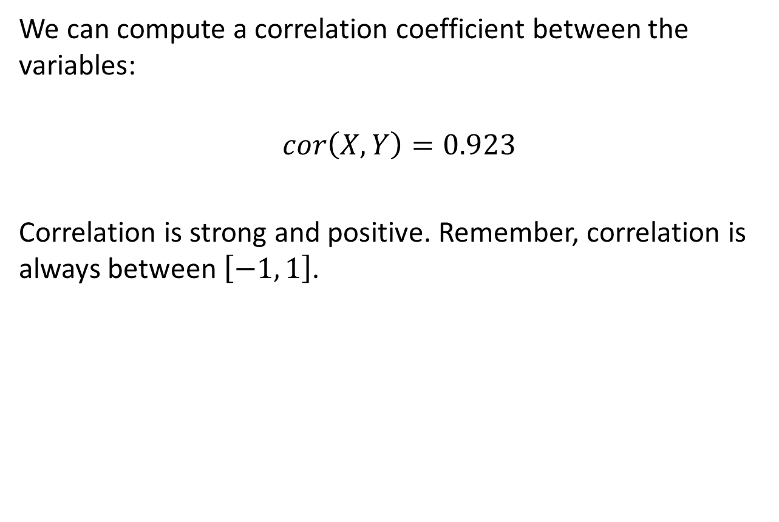
Correlation coefficient
We can compute a correlation coefficient between the variables:
$$cor\left(X, Y\right)=0.923$$
Correlation is strong and positive. Remember, correlation is always between $\left[−1, 1\right]$.

Slide 7
Fitted line
The least squares method is a procedure for using sample data to find the estimated regression equation. The equation can be plotted as a fitted line in the scatter graph.

Slide 8

Least square criterion
The fitted line should be as close as possible to the dots. This is an optimisation using the least squares criterion:
$$Min\sum{{\left(Y_{i}−{\hat{Y}}_{i}\right)}^{2}}$$

Slide 9
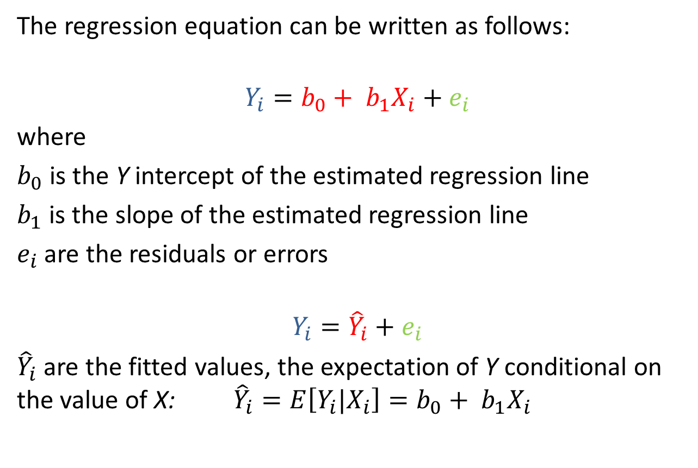
The regression equation
The regression equation can be written as follows:
$$Y_{i}=b_{0}+ b_{1}X_{i}+e_{i}$$
where
$b_{0}$ is the Y intercept of the estimated regression line
$b_{1}$ is the slope of the estimated regression line
$e_{i}$ are the residuals or errors
$$Y_{i}={\hat{Y}}_{i}+e_{i}$$
${\hat{Y}}_{i}$ are the fitted values, the expectation of Y conditional on the value of X: ${\hat{Y}}_{i}=E\left[Y_{i}|X_{i}\right]=b_{0}+ b_{1}X_{i}$

Slide 10
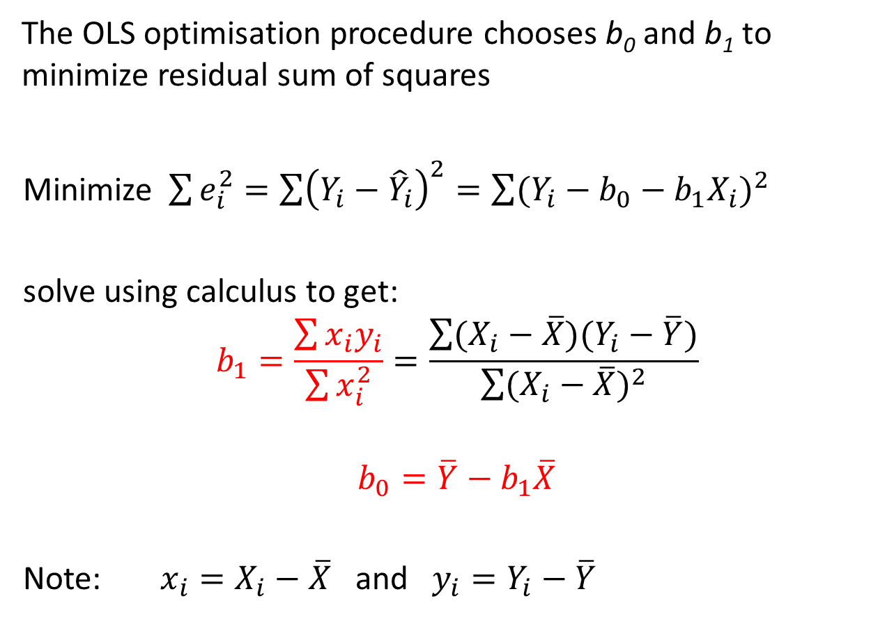
How to compute the coefficients
The OLS optimisation procedure chooses b₀ and b₁ to minimize residual sum of squares
Minimize $\sum{e_{i}^{2}=\sum{{\left(Y_{i}−{\hat{Y}}_{i}\right)}^{2}}=\sum{{(Y_{i}−b_{0}−b_{1}X_{i})}^{2}}}$
solve using calculus to get:
$$b_{1}=\frac{\sum{x_{i}y_{i}}}{\sum{x_{i}^{2}}}=\frac{\sum{(X_{i}−\overline{X})(Y_{i}−\overline{Y})}}{\sum{{(X_{i}−\overline{X})}^{2}}}$$
$$b_{0}=\overline{Y}−b_{1}\overline{X}$$
Note: $x_{i}=X_{i}−\overline{X}$ and $y_{i}=Y_{i}−\overline{Y}$

Slide 11
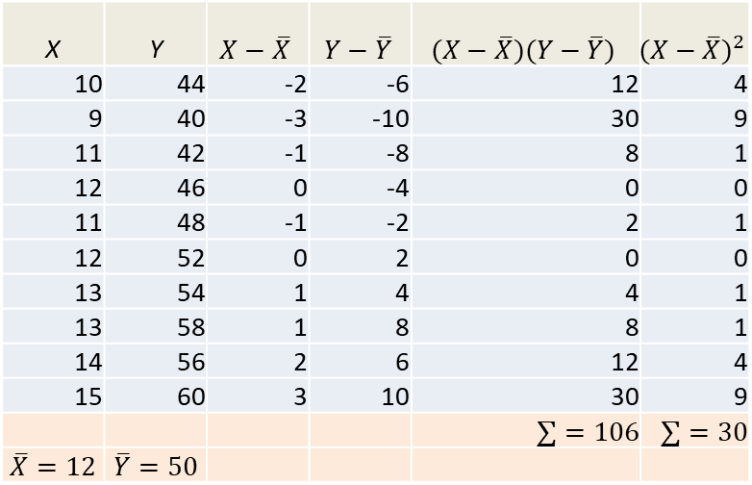

Estimated coefficients for the advertisement example
$$b_{1}=\frac{\sum{(X_{i}−\overline{X})(Y_{i}−\overline{Y})}}{\sum{{(X_{i}−\overline{X})}^{2}}}=\frac{106}{30}=3.533$$
$$b_{0}=\overline{Y}−b_{1}\overline{X}=50−3.533∗12=7.604$$
X | Y | $$X−\overline{X}$$ | $$Y−\overline{Y}$$ | $$(X−\overline{X})(Y−\overline{Y})$$ | $${(X−\overline{X})}^{2}$$
10 | 44 | -2 | -6 | 12 | 4
9 | 40 | -3 | -10 | 30 | 9
11 | 42 | -1 | -8 | 8 | 1
12 | 46 | 0 | -4 | 0 | 0
11 | 48 | -1 | -2 | 2 | 1
12 | 52 | 0 | 2 | 0 | 0
13 | 54 | 1 | 4 | 4 | 1
13 | 58 | 1 | 8 | 8 | 1
14 | 56 | 2 | 6 | 12 | 4
15 | 60 | 3 | 10 | 30 | 9
 |  |  |  | $$∑=106$$ | $$∑=30$$
$$\overline{X}=12$$ | $$\overline{Y}=50$$

Slide 12
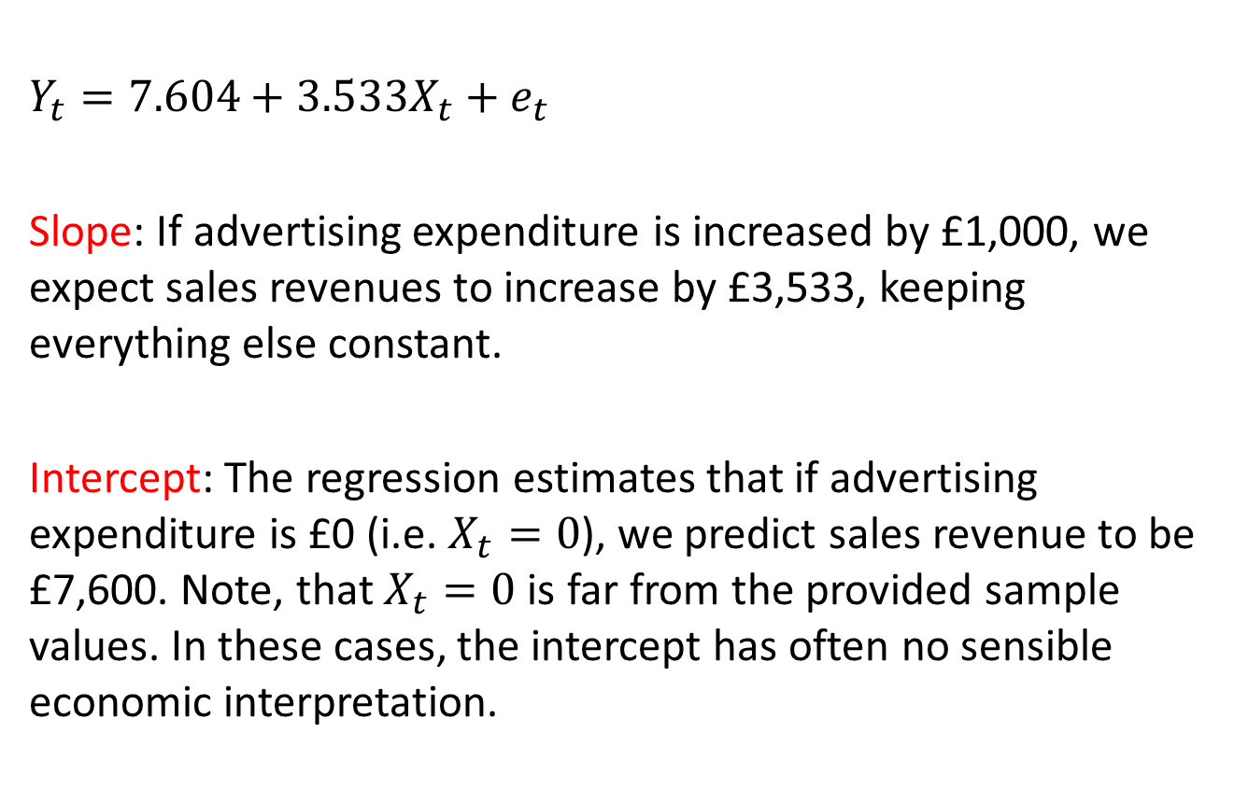
Interpretation of coefficients
$Y_{t}=7.604+3.533X_{t}+e_{t}$
Slope: If advertising expenditure is increased by £1,000, we expect sales revenues to increase by £3,533, keeping everything else constant.
Intercept: The regression estimates that if advertising expenditure is £0 (i.e. $X_{t}=0$), we predict sales revenue to be £7,600. Note, that $X_{t}=0$ is far from the provided sample values. In these cases, the intercept has often no sensible economic interpretation.

Slide 13
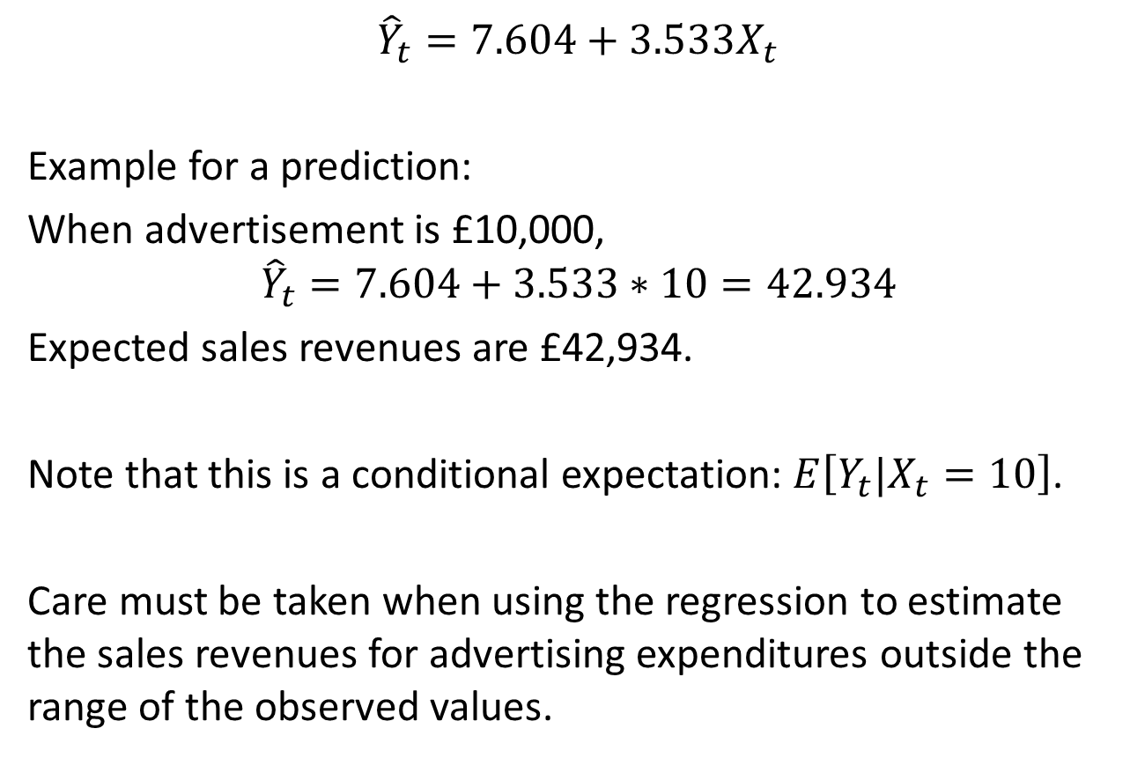
Prediction
$${\hat{Y}}_{t}=7.604+3.533X_{t}$$
Example for a prediction:
When advertisement is £10,000,
$${\hat{Y}}_{t}=7.604+3.533∗10=42.934$$
Expected sales revenues are £42,934.
Note that this is a conditional expectation: $E\left[Y_{t}|X_{t}=10\right]$.
Care must be taken when using the regression to estimate the sales revenues for advertising expenditures outside the range of the observed values.

Slide 14
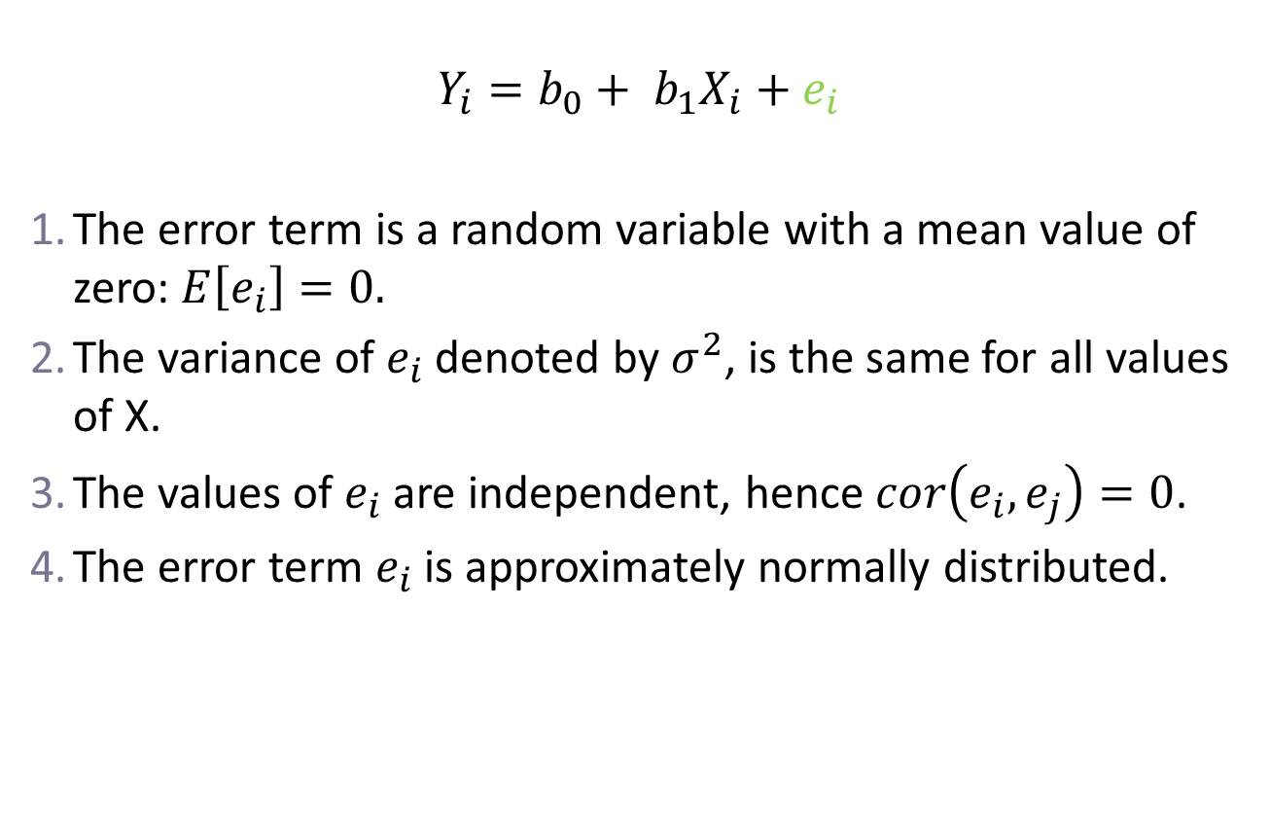
Assumptions on the error term
$$Y_{i}=b_{0}+ b_{1}X_{i}+e_{i}$$
The error term is a random variable with a mean value of zero: $E\left[e_{i}\right]=0.$
The variance of $e_{i}$ denoted by $σ^{2}$, is the same for all values of X.
The values of $e_{i}$ are independent, hence $cor\left(e_{i},e_{j}\right)=0$.
The error term $e_{i}$ is approximately normally distributed.

Slide 15
Next Lecture
Regression inference
Standard errors
Significance test for regression coefficients (t test)

